Slide 1



AIRBNB DATA ANALYSIS
BY:
Meghasham Parab

Slide 2
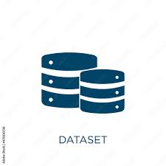
Overview of Dataset
Column Name | Description
id | Unique ID for each listing
name | Title or name of the listing (e.g., “Tiny Studio Apartment”)
host_id | Unique ID of the host
host_name | Name of the host
neighbourhood_group | (All values missing) – likely an unused or deprecated field
neighbourhood | Neighborhood where the listing is located (e.g., Logan Square, West Town)
latitude / longitude | Geographical coordinates
room_type | Type of accommodation: Entire home/apt, Private room, Shared room
price | Price per night in USD
minimum_nights | Minimum stay required for booking
number_of_reviews | Total number of reviews received
last_review | Date of the most recent review
reviews_per_month | Average number of reviews per month
calculated_host_listings_count | Number of listings a host has on the platform
availability_365 | Number of days the listing is available in a year
number_of_reviews_ltm | Number of reviews in the last 12 months
license | License number for the listing (for regulatory compliance)

Slide 3
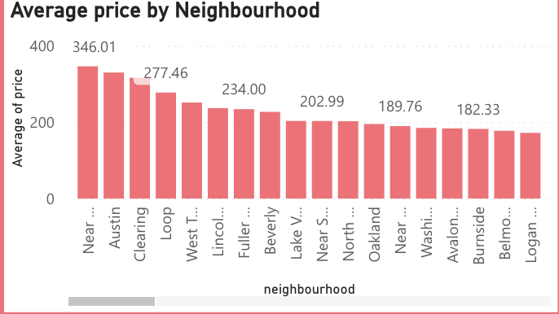
Average Price by Neighbourhood
Top 5 Neighborhoods by Average Price:
Near – 346.01
Austin – slightly below 346.01
Clearing – 277.46
Loop – slightly below 277.46
West T. – estimated between 250–270 range

Slide 4
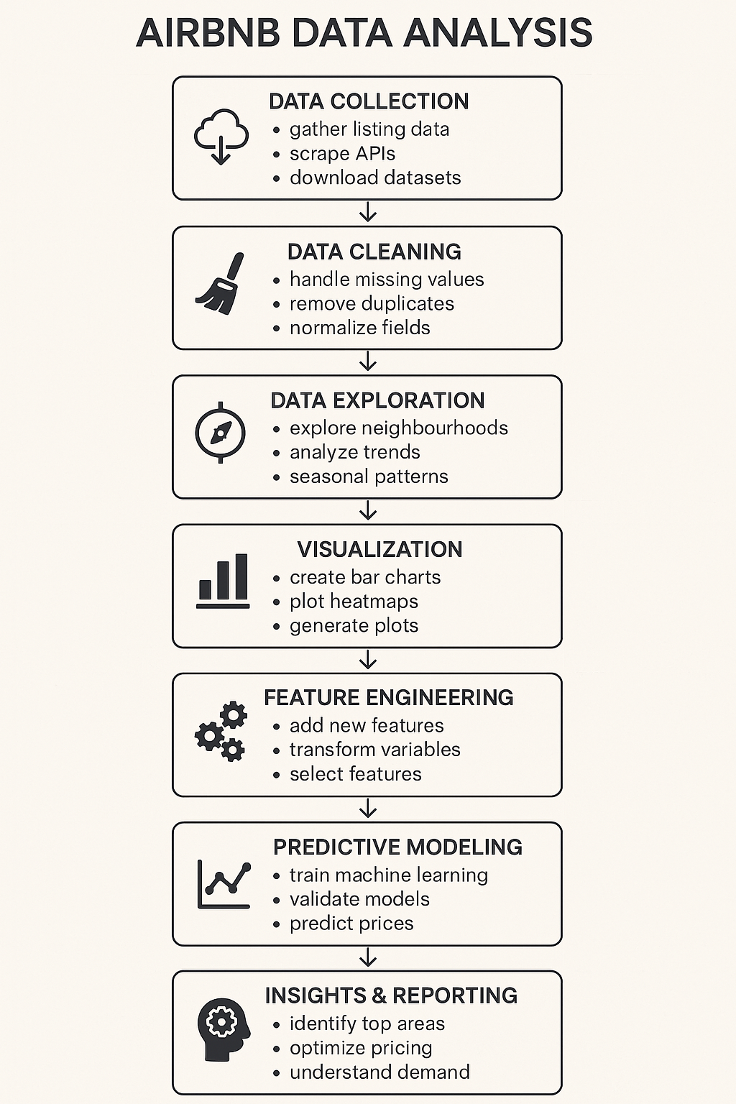

Overview Of The Project
Data Collection – Gathering listing data via APIs or datasets.
Data Cleaning – Preparing the data by handling missing values and normalizing fields.
Data Exploration – Analyzing trends, neighborhoods, and seasonal patterns.
Visualization – Creating visual representations such as bar charts and heatmaps.
Feature Engineering – Developing new variables to enhance analysis.
Predictive Modeling – Training machine learning models to predict prices.
Insights & Reporting – Extracting valuable insights for decision-making, such as optimizing pricing and identifying high-demand areas.

Slide 5
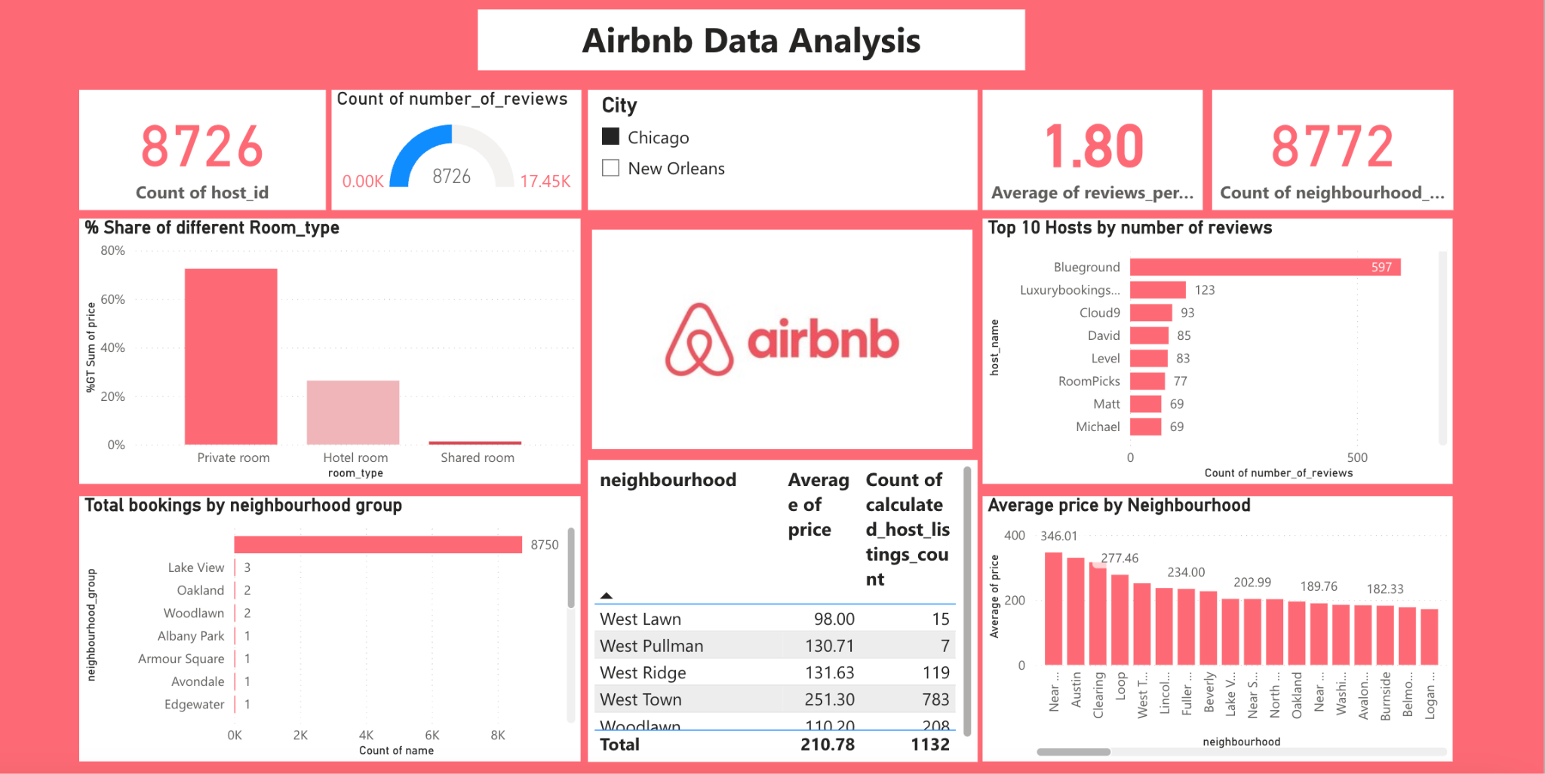


Analysing And Visualizing Data On Power BI Platform

Slide 6
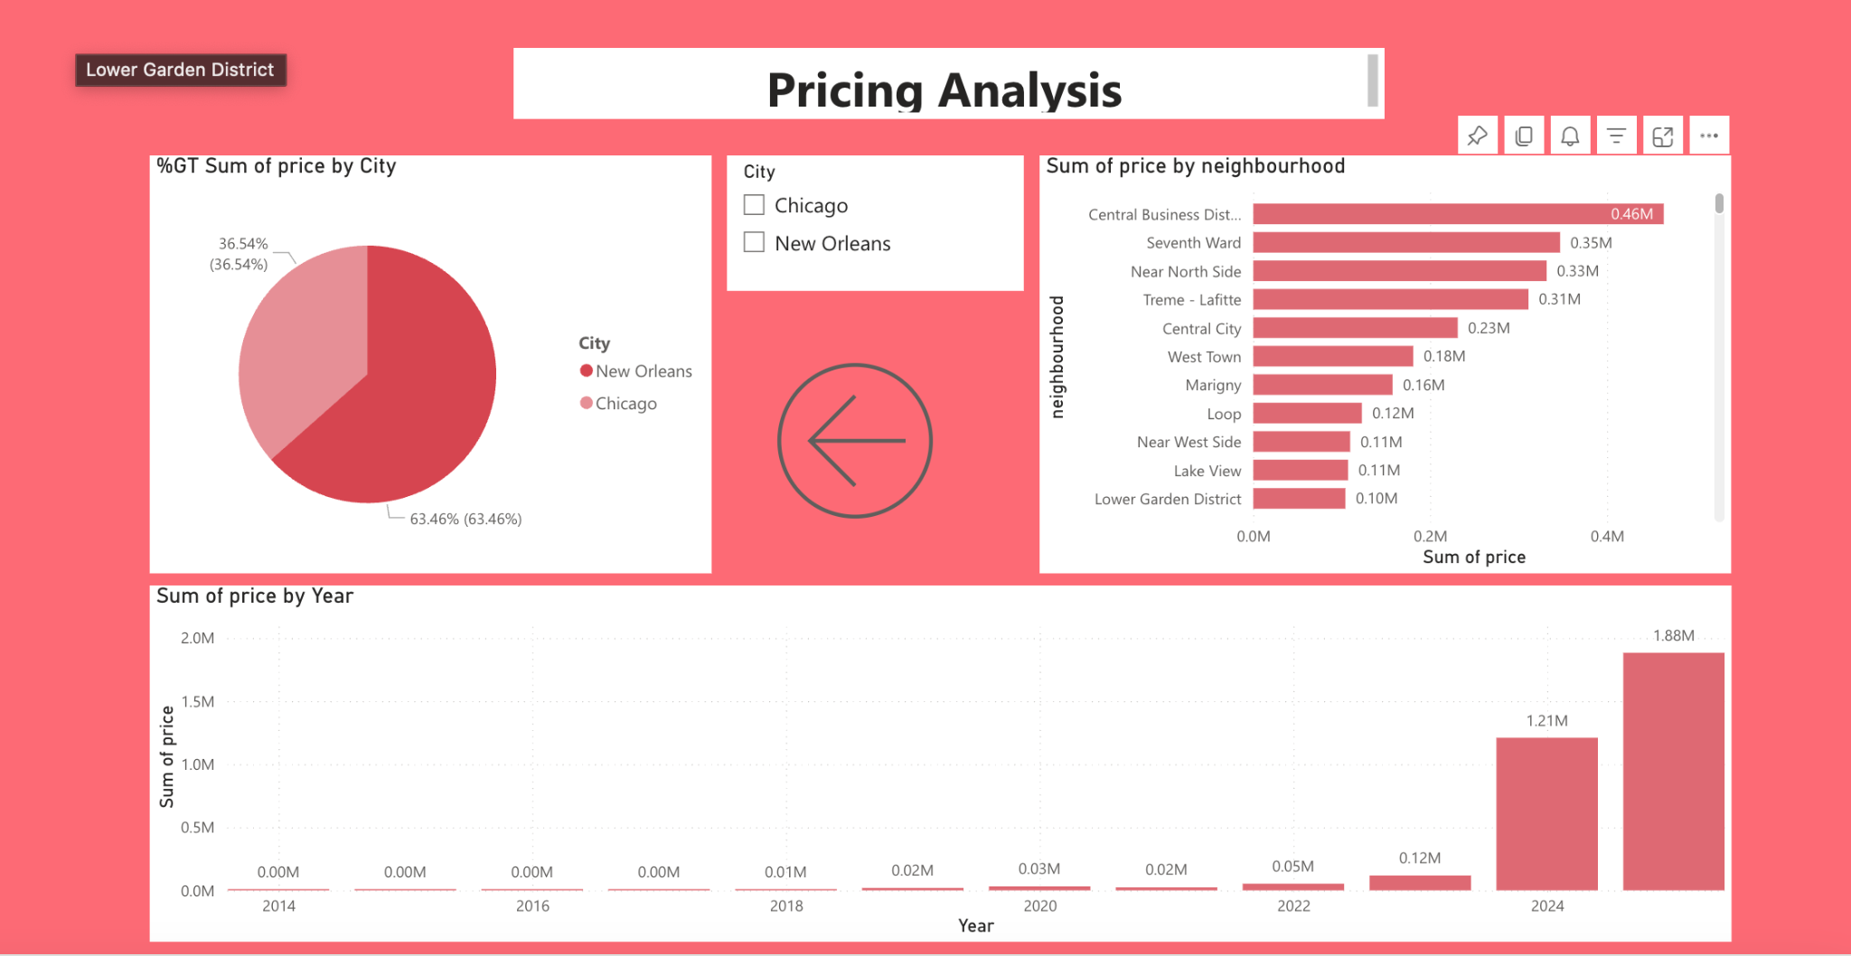

Slide 7
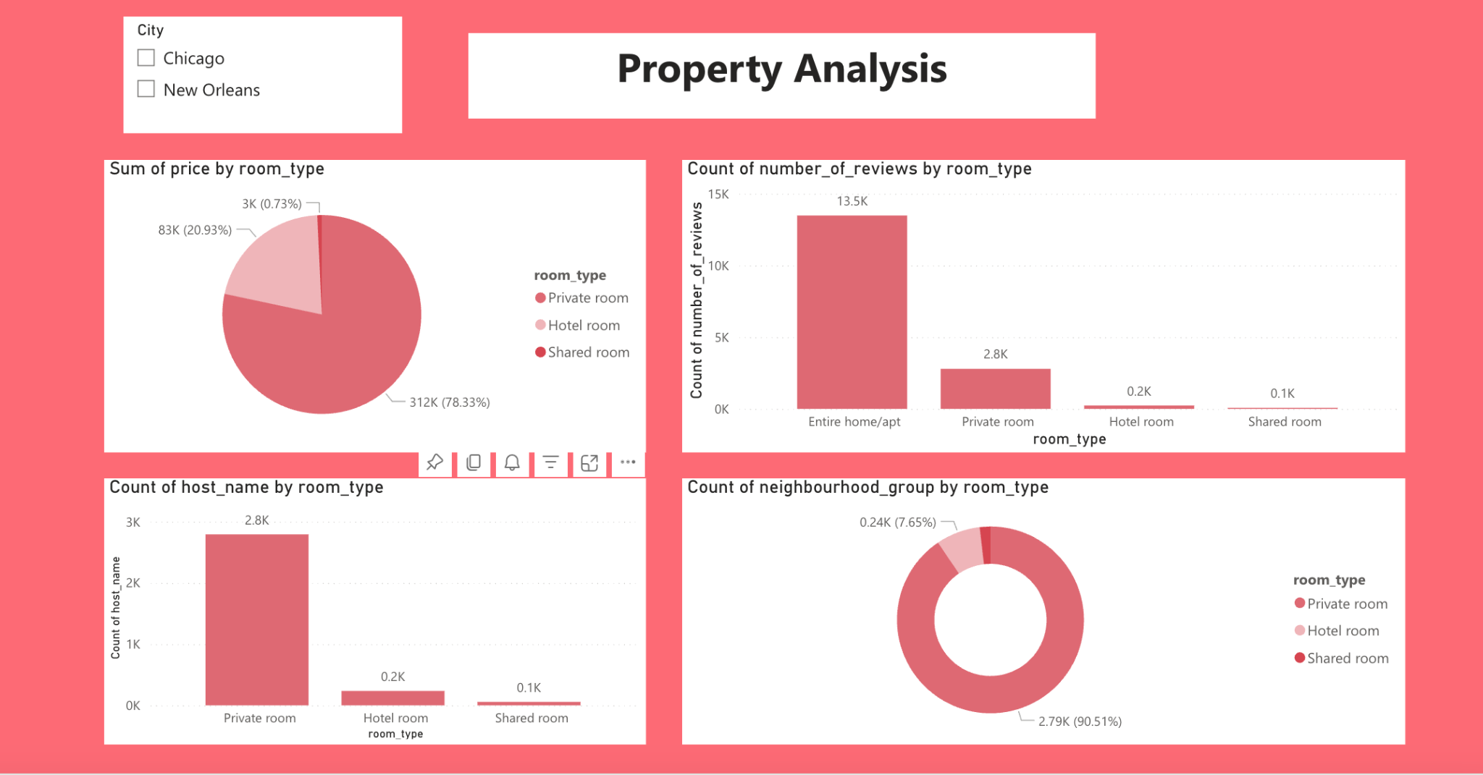

Slide 8

Conclusion
The Airbnb Data Analysis flowchart provides a comprehensive roadmap for transforming raw listing data into valuable business insights. By systematically moving through data collection, cleaning, exploration, visualization, feature engineering, and predictive modeling, analysts can uncover patterns in pricing, demand, and neighborhood performance.

